Slide 1
CNAO’s Cooperation with External Partners
Wang Guanqun, CNAO
At the 12th Meeting of INTOSAI WGVBS
April 2019, Vienna, Austria

Slide 2
In its audit investigation and utilization of results, CNAO attaches great importance to the cooperation with its external partners to promote the value and benefits of the SAI.

Slide 3
Organization
departments
Stakeholders
1
3
2
4
Competent
authorities
Government
agencies

Slide 4
Stakeholders

Slide 5
Stakeholders
Central Audit Commission of the CPC
CNAO
Premier
National People’s Congress

Slide 6
Stakeholder – Central Audit Commission
Audit Report on Central Budget Implementation and Other Government Revenues and Expenditures
Central Audit Commission was established by the Communist Party of China (CPC) with its general office set up at the National Audit Office in March 2018
Chair of the Central Audit Commission - CPC General Secretary Xi Jinping

Slide 7
Stakeholder – Premier
Article 86. The State Council is composed of the following: The Premier; The Vice-Premiers; The State Councillors; The Ministers in charge of Ministries; The Ministers in charge of Commissions; The Auditor- General; and The Secretary-General.
Article 91. The State Council establishes an auditing body to supervise through auditing the revenue and expenditure of all departments under the State Council and of the local governments at different levels.
-- Constitution of the People’s Republic of China
Audit Reports
Audit Reports
Audit Reports
Audit reports

Slide 8
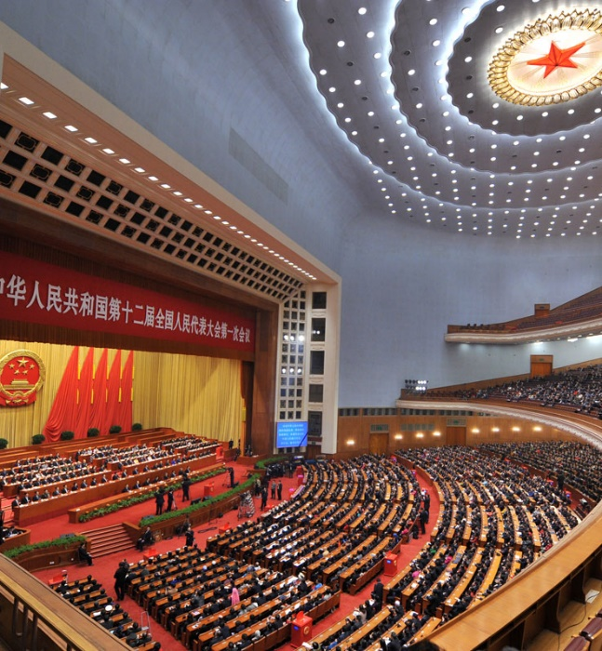
Stakeholder – NPC
Entrusted by the State Council, the Auditor General reports to the Standing Committee of the National People’s Congress every year.
Audit Report on Central Budget Implementation and Other Government Revenues and Expenditures
Audit Report on the Rectifications of Previous Audit Findings

Slide 9
Auditor General Ms. Hu Zejun reports to the Standing Committee of the NPC
At the 3rd Plenary Session of the 13th Meeting of the Standing Committee of the National People’s Congress, on 20 June 2018

Slide 10
Stakeholder – NPC
Example:
We made recommendations on the publication of budget execution, reform of financial management system, improvement of the accountability mechanism, etc., to the NPC.
The Budget Law of the People’s Republic of China was amended by the NPC in 2018, taking into consideration of the recommendations made by the CNAO.

Slide 11
Competent authorities

Slide 12
Competent authorities
CPC discipline inspection commissions / National supervisory commissions
CNAO
Public security departments
People’s procuratorates

Slide 13
Competent authorities
Violations of disciplines
Discipline inspection commissions / National supervisory commissions
Trails
Criminal acts
Judicial organs

Slide 14
Competent authorities
31,000 cases
have been transferred to discipline inspection commissions / national supervisory commissions or judicial organs since 2013

Slide 15
Organization departments

Slide 16
Organization departments
Economic Accountability Audit of Leading Officials
Heads of CPC committees
Heads of governments
Heads of SOEs

Slide 17
Organization departments
193,600 officials
have been audited by audit institutions of China since 2013

Slide 18
Organization departments
Organization (HR) departments
Appointment
Evaluation
Promotion
CNAO

Slide 19
Government agencies

Slide 20
Government agencies
Public security
Supervision
Finance
Taxation
Customs
Pricing
Market regulation
etc.
Professional
support
CNAO’s investigations

Slide 21
Government agencies
Example:
When carrying out environmental audits, CNAO asks environmental protection departments and professional organizations for assistance in making judgements on professional issues and specific data.

Slide 22
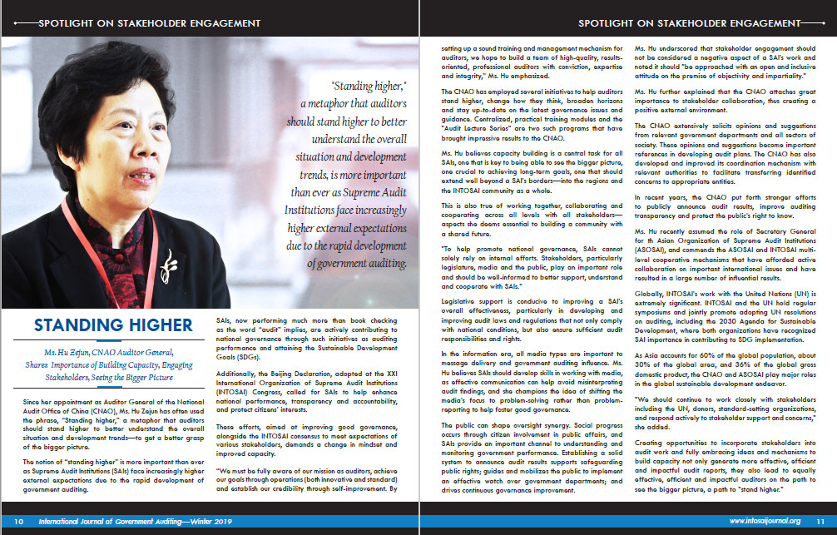
“To help promote national governance, SAIs cannot solely rely on internal efforts. Stakeholders, particularly legislature, media and the public, play an important role and should be well-informed to better support, understand and cooperate with SAIs.”
-- Says Ms. Hu Zejun, CNAO Auditor General, during an interview with INTOSAI Journal

Slide 23
Thank you
wangguanqun@audit.gov.cn

